Slide 1
Review 2
-2010030151 K S Satyavarsan
2010030071 Jyothin Movva
2010030040 Devaraj Acharya
2010030341 Snehith Kamepally
2010030329 Karthik

Slide 2
Abstract
The field of human resources analysis, which can be understood as an approach to human recourses management focused on data and analytical thinking.
Human resources analysis an optimal use of human resources to ensure that the human resources of an organization remain an asset and not a liability.
The project analyzes the data of the employees working in the organization.

Slide 3
Documentation

Slide 4
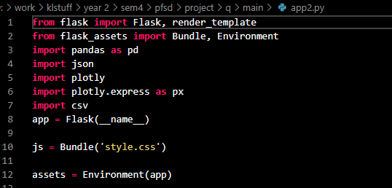
Libraries and flask initialisation

Slide 5
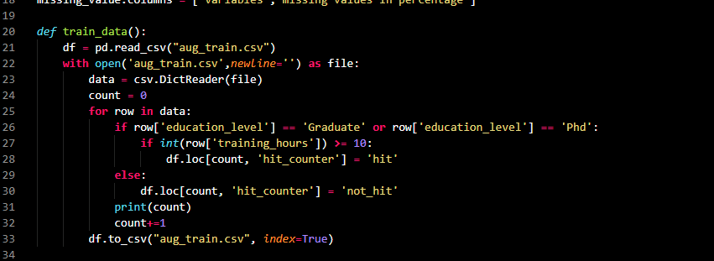
Generating new result

Slide 6
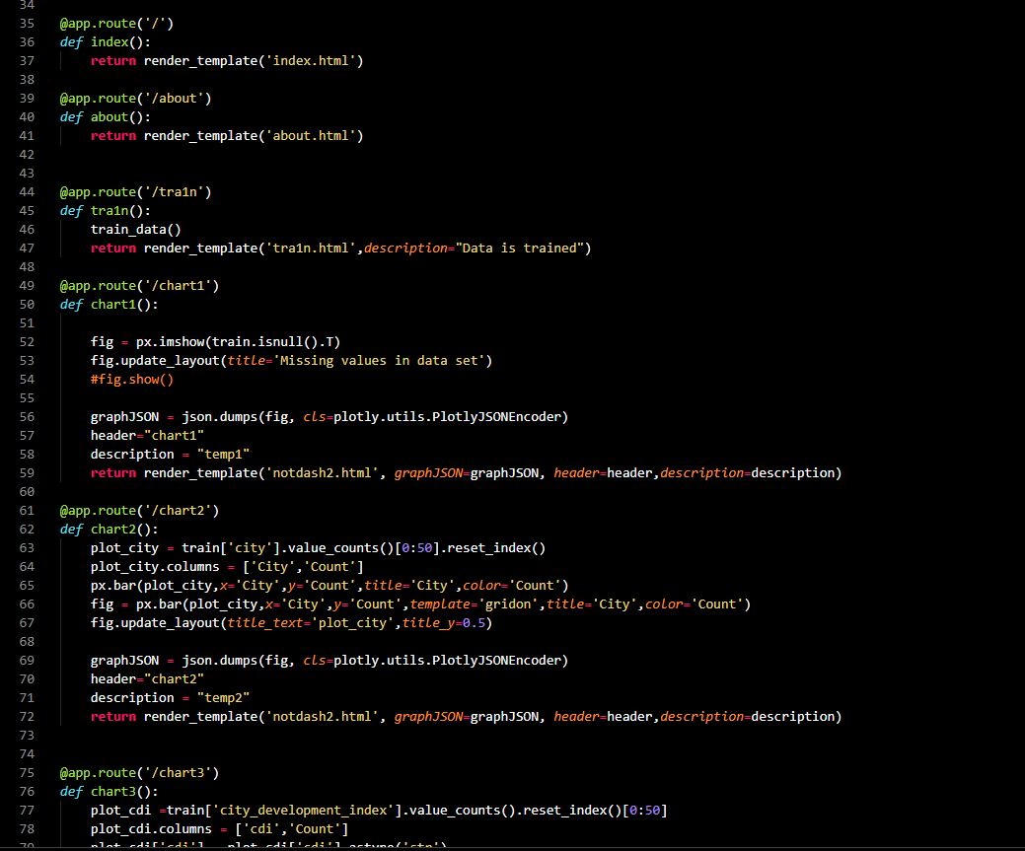
Flask links and chart plotting

Slide 7
methods
The project is coded in python
The dependencies that are used are
Numpy – mathematical functions
Pandas – data analysis and manipulation
Ploty – plot 2d data and color scaling functionality
Flask - website hosting

Slide 8
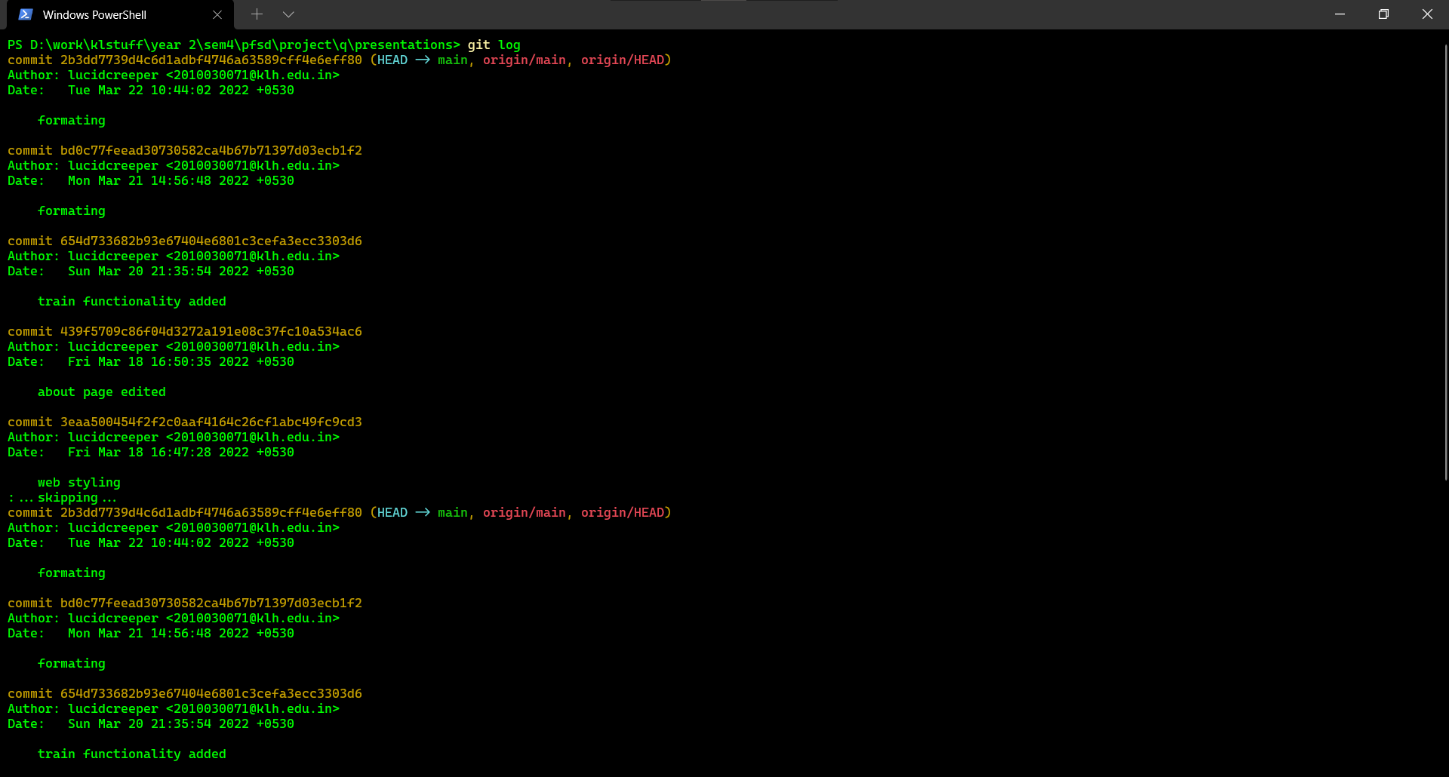
GITHUB COMMITS

Slide 9
Work progress
Flask environment for the project is functional
Generating plots from the given data is functional
Using data to create a new field, and plotting a graph from the generated data

Slide 10
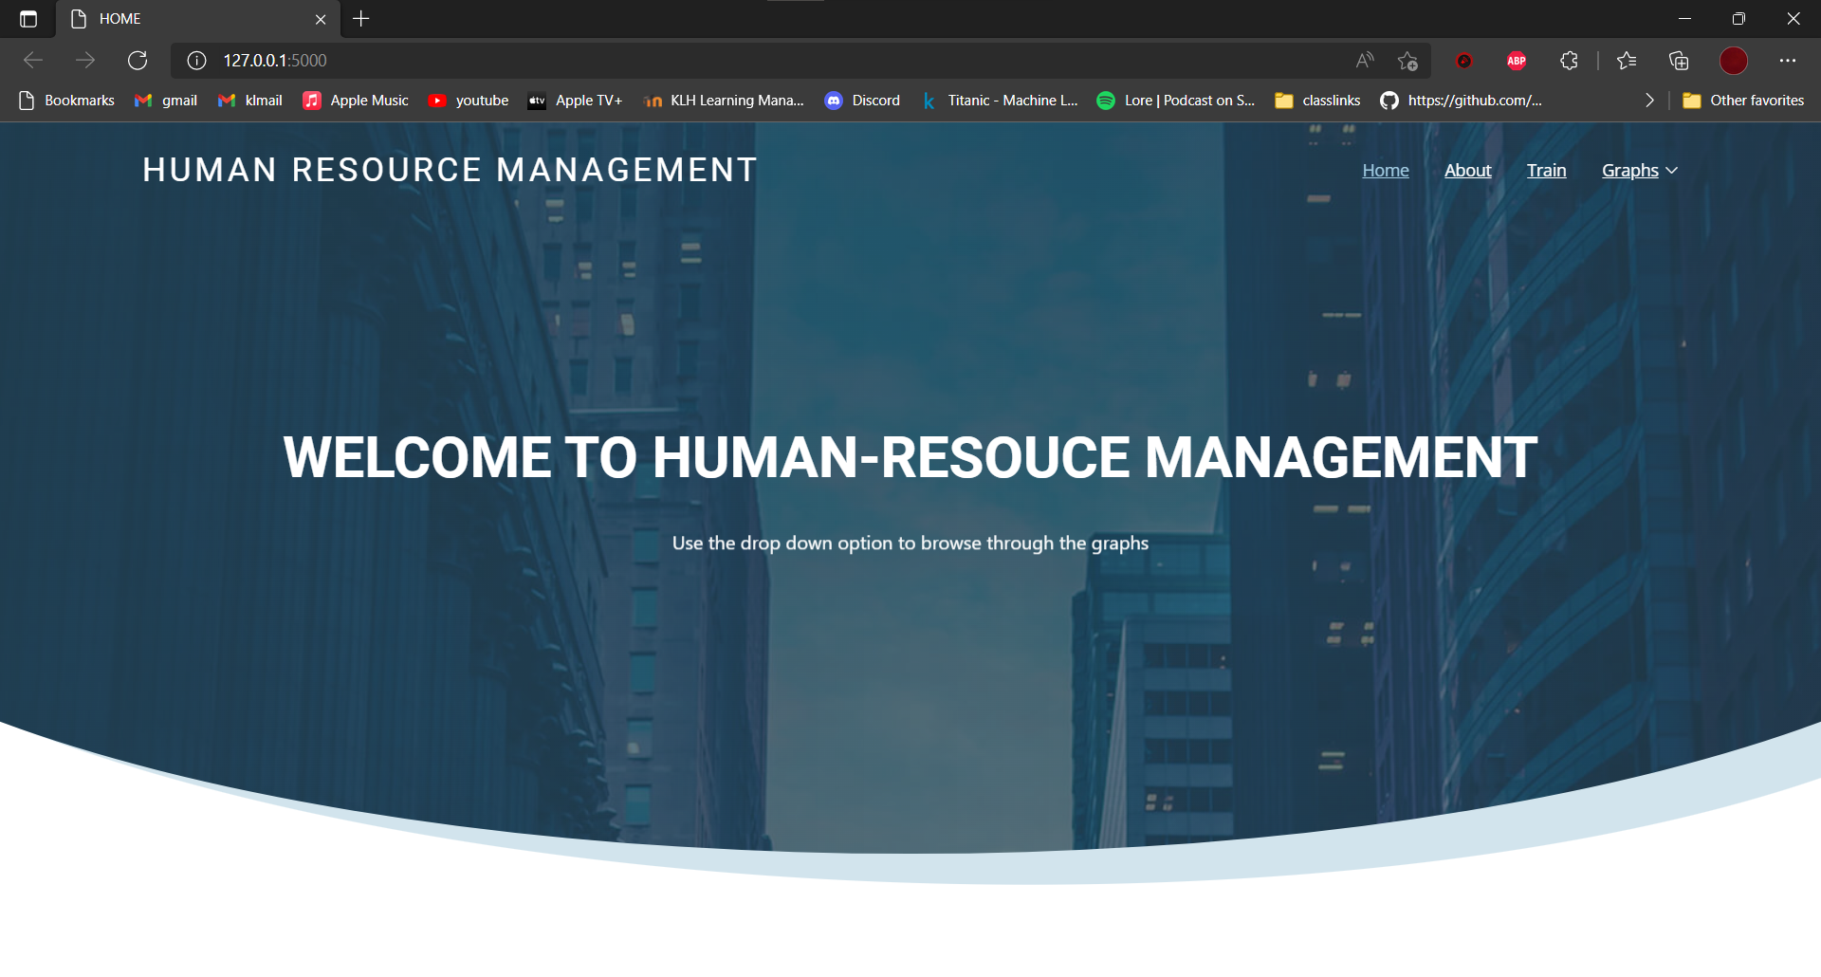
Beta testing

Slide 11
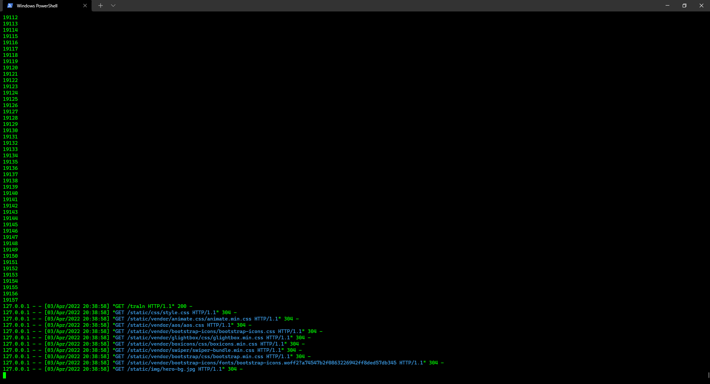
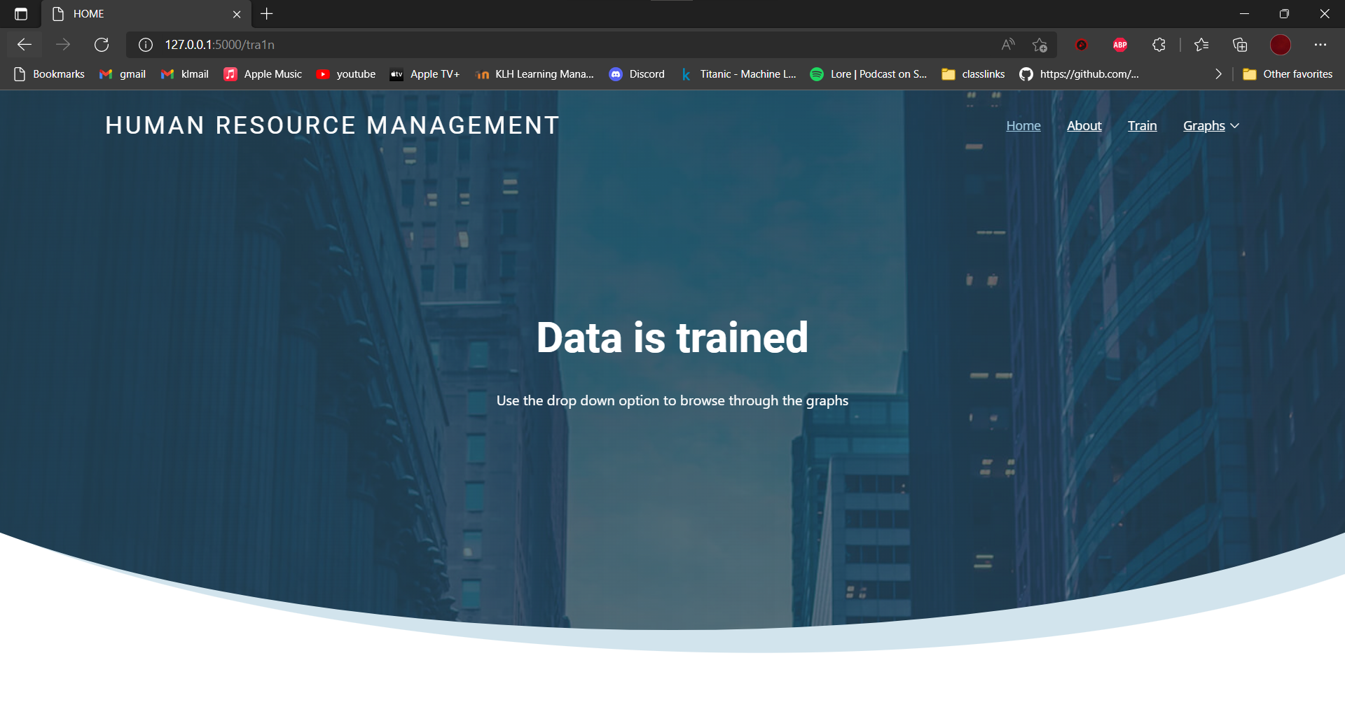

Slide 12
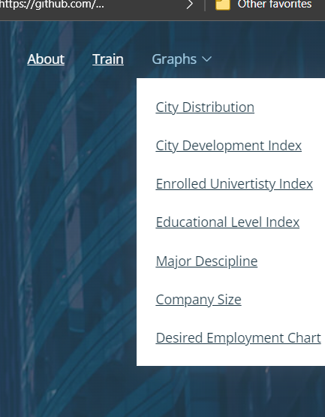
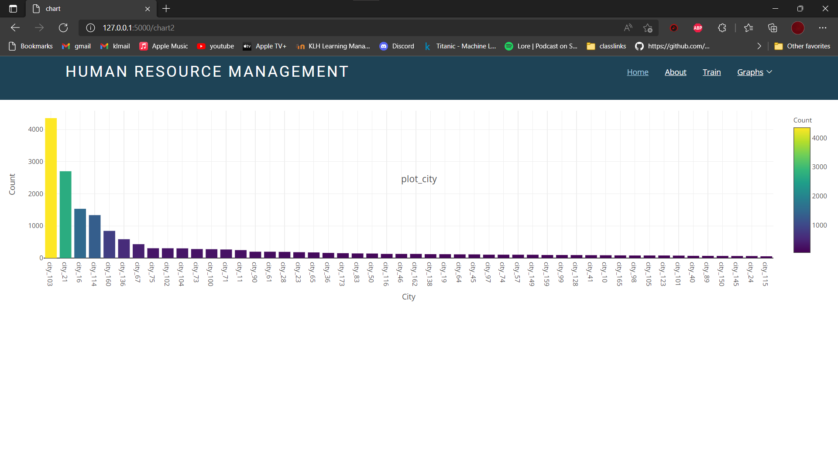

Slide 13
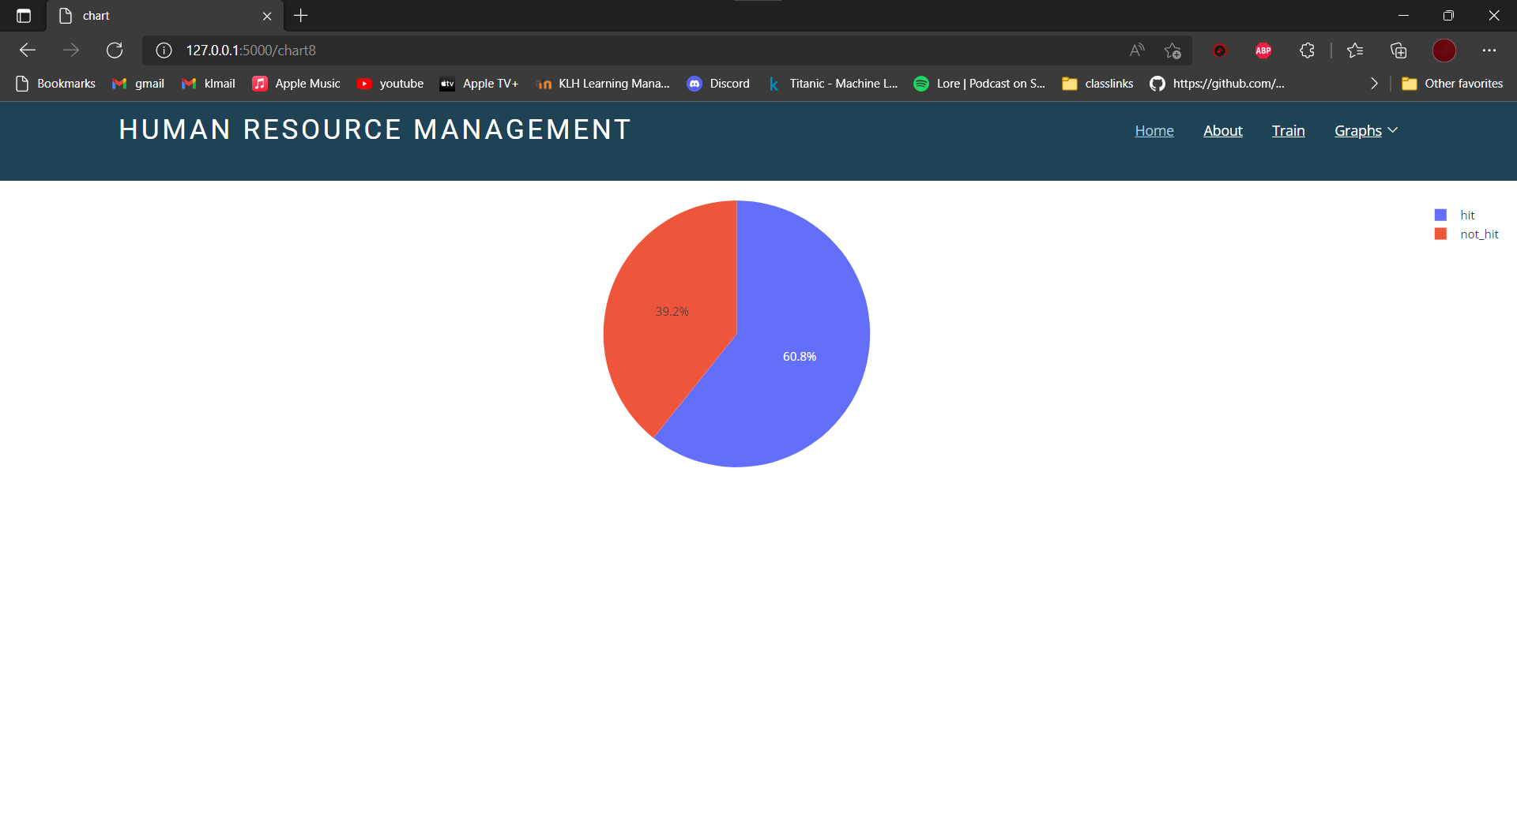

Slide 14
Suggestions

Slide 15
Thank you

